Slide 1

Natural Language Processing: Core Concepts and Techniques
Understanding Word Embeddings, Similarity Measures, and Text Classification
Natural Language Processing Training Session

Slide 2
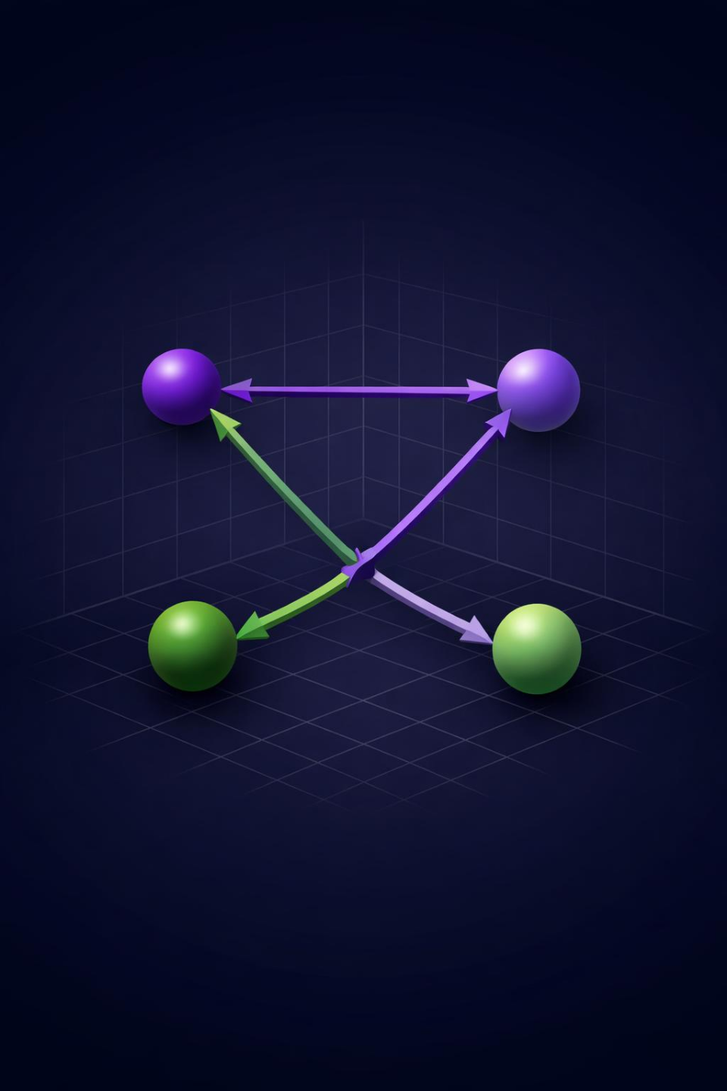
What are Word Embeddings?
Dense Vector Representations [2]
Similar Meanings = Similar Vectors [1]
Dense vector representations of words in lower-dimensional space that capture semantic and syntactic information [2]
Words with similar meanings are positioned close together in vector space, enabling machines to understand relationships [1]
Transforms text from discrete symbols into continuous numerical values that machine learning models can process effectively
Essential foundation for modern NLP tasks including translation, sentiment analysis, and information retrieval

Slide 3
Word2Vec and GloVe Approaches
Aspect | Word2Vec | GloVe
Method | Predictive (Neural Network) | Count-based (Co-occurrence Matrix)
Architecture | CBOW and Skip-gram models | Matrix factorization
Context | Local context windows | Global corpus statistics
Strength | Captures contextual relationships | Captures global patterns
Word2Vec developed by Google in 2013 uses two architectures: CBOW predicts target word from context, Skip-gram predicts context from target word [1]
GloVe introduced by Stanford in 2014 constructs word co-occurrence matrix from entire corpus and factorizes it to generate embeddings [3]
Both methods create dense vectors where semantic similarity translates to spatial proximity in vector space
Choice between methods depends on dataset size, computational resources, and whether local or global context matters more
Sources:
GloVe vs. Word2Vec: Choosing the Right Embedding for NLP
Glove Word Embedding in NLP - GeeksforGeeks

Slide 4
Compute Dot Product
Multiply corresponding vector elements and sum (A·B)
Measuring Similarity with Cosine
Calculate Magnitudes
High-Dimensional Effective [4]
Find length of each vector using square root of sum of squares
Direction Over Magnitude [5]
Range: -1 to +1 [4]
Calculates angle between vectors in high-dimensional space [4]
Focuses on direction, not magnitude, making it magnitude-invariant [5]
Effective for text where document length shouldn't affect similarity
Used in semantic search, recommendations, and document clustering [5]
Divide Results
Cosine similarity = (A·B) / (||A|| × ||B||)
Interpret Score
+1 means identical, 0 means unrelated, -1 means opposite

Slide 5
Text Classification Fundamentals
Common applications include spam detection, sentiment analysis, news categorization, and customer support ticket routing [7]
Traditional machine learning uses algorithms like Naive Bayes, Support Vector Machines, and Logistic Regression with engineered features [6]
Deep learning approaches with transformers like BERT have revolutionized the field by understanding context without manual feature engineering
Automated Categorization [6]
Spam Detection to Sentiment [7]
TF-IDF or Embeddings [6]
Text classification is the automated process of categorizing text documents into predefined categories or labels [7]
Process involves preprocessing, feature extraction using TF-IDF or embeddings, model training, and prediction [6]
Feature extraction transforms raw text into numerical representations that classification algorithms can process effectively

Slide 6
Classification Techniques in Practice
Traditional ML algorithms like Naive Bayes and SVM excel with limited data, fast training, and model interpretability [6]
Deep learning with CNNs and LSTMs captures sequential dependencies and local patterns effectively for contextual analysis
Transformer models like BERT and DistilBERT outperform traditional approaches by understanding bidirectional context [7]
Model selection depends on dataset size, computational resources, latency requirements, and explainability needs
Source: Text Classification with NLP A Complete Guide 2026

Slide 7
THANK YOU

